Slide 1
ZoopR-dooper zooplankton: Automating integration of IEP datasets

Slide 2
Inputs
EMP
FMWT
FRP
Flat files online
Environmental data and CPUE in same file
Combined Data Set
20mm
Access files online
Environmental data and counts are in separate files
CPUE needs to be calculated in code
Notes:
EMP, FMWT, and FRP Datasets
EMP and FMWT are in flat files online – simple to load into R with a line of code
counts are in the same file
20mm Dataset
20mm are in Access files – not as simple to load into R
CPUE is not calculated – must be done in code
Similar methods
Discrepancies in taxonomic classification and environmental variables

Slide 3
Input data processing
Station | Volume | Taxa | CPUE
NZ020 | 1.8 | PDIAPFOR | 870
NZ020 | 2.5 | PDIAPFOR | 4819
NZ020 | 3.8 | PDIAPFOR | 571
NZ020 | 1.8 | OITHDAV | 0
NZ020 | 2.5 | OITHDAV | 0
NZ020 | 3.8 | OITHDAV | 0
Rename columns, gather rows
Station | CBVolume | PDIAPFOR | OITHDAV
NZ020 | 1.8 | 870 | 0
NZ020 | 2.5 | 4819 | 0
NZ020 | 3.8 | 571 | 0
Add taxonomic info, latitude, and longitude
Station | Volume | Lat | Long | Taxname | Genus | Family | …. | CPUE
NZ020 | 1.8 | 38.031 | -122.135 | Pseudodiaptomus forbesii | Pseudodiaptomus | Pseudodiaptomidae |  | 870
NZ020 | 2.5 | 38.031 | -122.135 | Pseudodiaptomus forbesii | Pseudodiaptomus | Pseudodiaptomidae |  | 4819
NZ020 | 3.8 | 38.031 | -122.135 | Pseudodiaptomus forbesii | Pseudodiaptomus | Pseudodiaptomidae |  | 571
NZ020 | 1.8 | 38.031 | -122.135 | Oithona davisae | Oithona | Oithonidae |  | 0
NZ020 | 2.5 | 38.031 | -122.135 | Oithona davisae | Oithona | Oithonidae |  | 0
NZ020 | 3.8 | 38.031 | -122.135 | Oithona davisae | Oithona | Oithonidae |  | 0

Slide 4
Merging datasets
Station | Volume | Taxname | Genus | Family | …. | CPUE
NZ020 | 1.8 | Pseudodiaptomus forbesii | Pseudodiaptomus | Pseudodiaptomidae |  | 870
NZ020 | 2.5 | Pseudodiaptomus forbesii | Pseudodiaptomus | Pseudodiaptomidae |  | 4819
NZ020 | 3.8 | Pseudodiaptomus forbesii | Pseudodiaptomus | Pseudodiaptomidae |  | 571
NZ020 | 1.8 | Oithona davisae | Oithona | Oithonidae |  | 0
NZ020 | 2.5 | Oithona davisae | Oithona | Oithonidae |  | 0
NZ020 | 3.8 | Oithona davisae | Oithona | Oithonidae |  | 0
Merge
Project | Station | Volume | Taxname | Genus | Family | …. | CPUE
EMP | NZ020 | 1.8 | Pseudodiaptomus forbesii | Pseudodiaptomus | Pseudodiaptomidae |  | 870
EMP | NZ020 | 2.5 | Pseudodiaptomus forbesii | Pseudodiaptomus | Pseudodiaptomidae |  | 4819
EMP | NZ020 | 3.8 | Pseudodiaptomus forbesii | Pseudodiaptomus | Pseudodiaptomidae |  | 571
EMP | NZ020 | 1.8 | Oithona davisae | Oithona | Oithonidae |  | 0
EMP | NZ020 | 2.5 | Oithona davisae | Oithona | Oithonidae |  | 0
EMP | NZ020 | 3.8 | Oithona davisae | Oithona | Oithonidae |  | 0
FMWT | 340 | 3.8 | Pseudodiaptomus forbesii | Pseudodiaptomus | Pseudodiaptomidae |  | 400
FMWT | 340 | 7.4 | Pseudodiaptomus forbesii | Pseudodiaptomus | Pseudodiaptomidae |  | 845
FMWT | 340 | 10.2 | Pseudodiaptomus forbesii | Pseudodiaptomus | Pseudodiaptomidae |  | 3147
FMWT | 340 | 3.8 | Oithona davisae | Oithona | Oithonidae |  | 58
FMWT | 340 | 7.4 | Oithona davisae | Oithona | Oithonidae |  | 852
FMWT | 340 | 10.2 | Oithona davisae | Oithona | Oithonidae |  | 1258
Station | Volume | Taxname | Genus | Family | …. | CPUE
340 | 3.8 | Pseudodiaptomus forbesii | Pseudodiaptomus | Pseudodiaptomidae |  | 400
340 | 7.4 | Pseudodiaptomus forbesii | Pseudodiaptomus | Pseudodiaptomidae |  | 845
340 | 10.2 | Pseudodiaptomus forbesii | Pseudodiaptomus | Pseudodiaptomidae |  | 3147
340 | 3.8 | Oithona davisae | Oithona | Oithonidae |  | 58
340 | 7.4 | Oithona davisae | Oithona | Oithonidae |  | 852
340 | 10.2 | Oithona davisae | Oithona | Oithonidae |  | 1258

Slide 5
Products
For R-users | For non-R users (or R-users interested in quick data exploration)
R functions | Interactive online R Shiny app
Download, integrate, and filter zooplankton datasets | Integrate, and filter zooplankton datasets
 | Visualize data with pre-set plots
 | Download final dataset to your computer to utilize with any statistics / graphing software

Slide 6
Products
For community data analyzers | For specific taxa analyzers
I want to analyze the community composition at whatever taxonomic level lets me use all these datasets. | I want all possible data on these specific taxa
Consistent taxonomic categories | Calculates total CPUE for higher taxonomic levels
No plankters counted more than once | Some plankters appear in multiple nested taxa (e.g., Calanoida, Copepoda)
Sacrifices some taxonomic resolution | Preserves taxonomic resolution and creates taxonomic categories comparable across all datasets
Removes taxa with no relatives in other datasets (e.g., Annelida) | Labels taxa that are comparable across all datasets, warns about those that are not.

Slide 7
Current features
Integrates CB data from EMP, FMWT, TNS, FRP, 20mm
Filter data by
Date
Month
Surface salinity
Latitude
Longitude

Slide 8
Open app
Notes:
https://zoopsynth.shinyapps.io/ZoopSynth/
https://zoopsynth.shinyapps.io/ZoopSynth_experimental/

Slide 9
Next steps
Add more datasets and mesh sizes.
Add more graphing capabilities to shiny app.
Package R functions into an R package

Slide 10
Questions for you
What capabilities would you like added to the shiny app or R functions?
What types of graphs would be most useful in the app?
How would you use our app / R functions? How can we make this easier?
Notes:
Add tidal stage to app, see if time of day is in more data
Add functionality to download graphs
Look into adding different surveys or regions to graphs as different lines Also maybe do ddifferent lines for different salinity regions

Slide 11
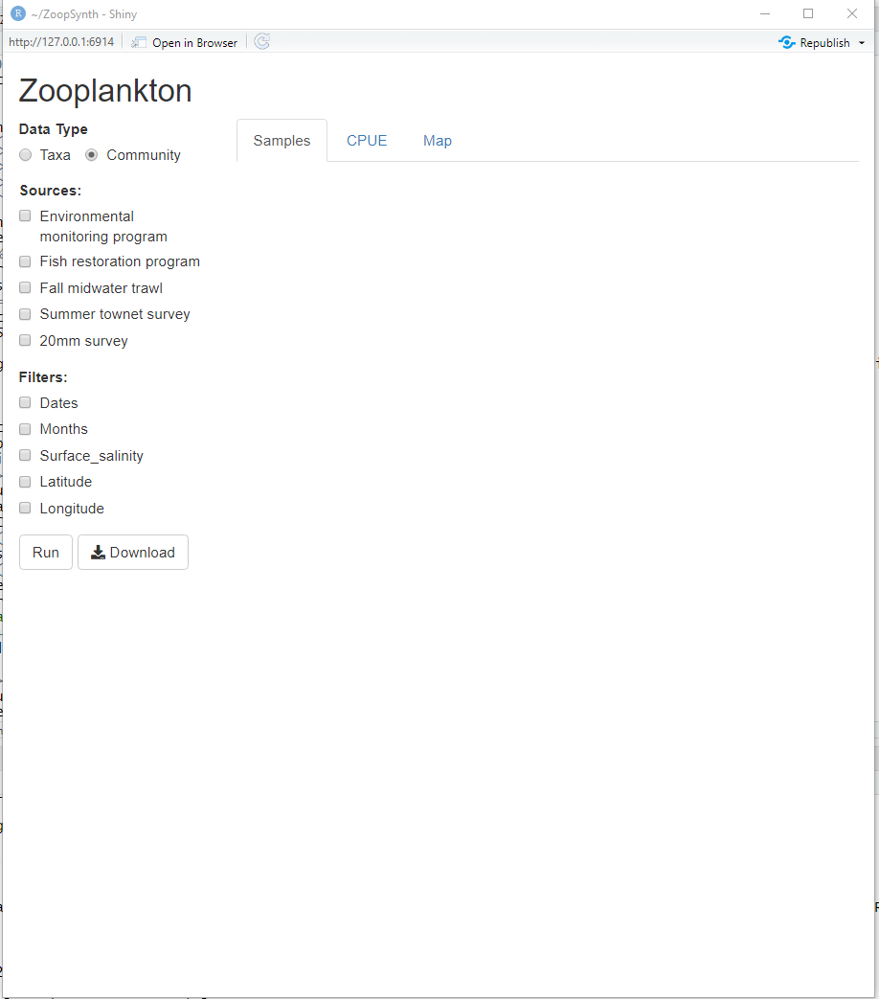

Slide 12
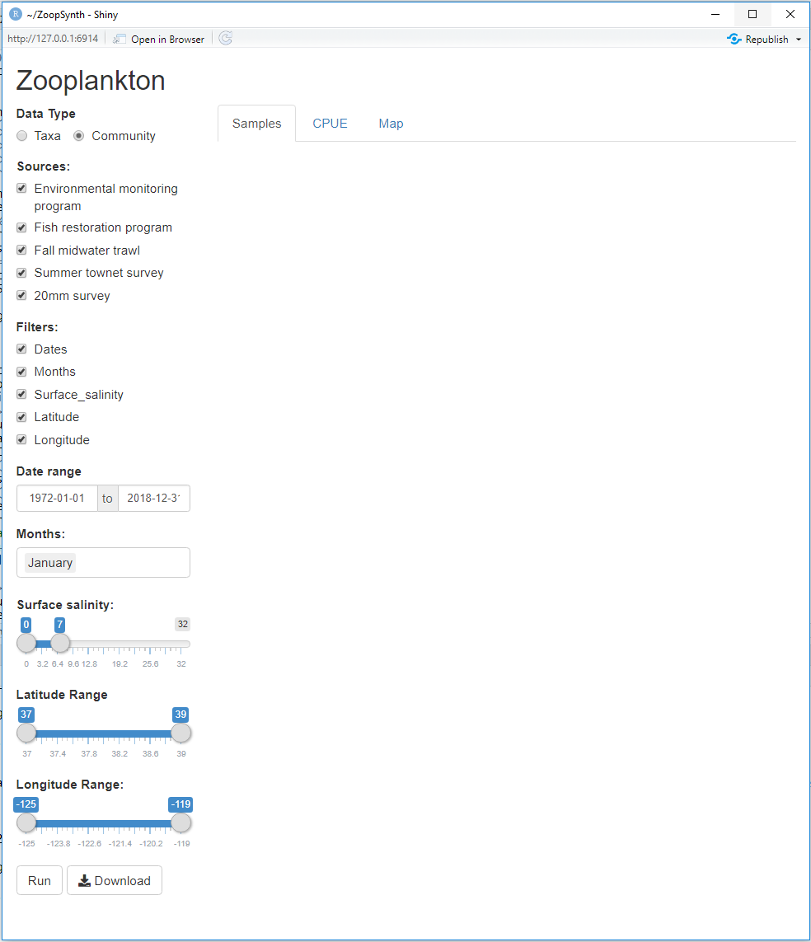

Slide 13
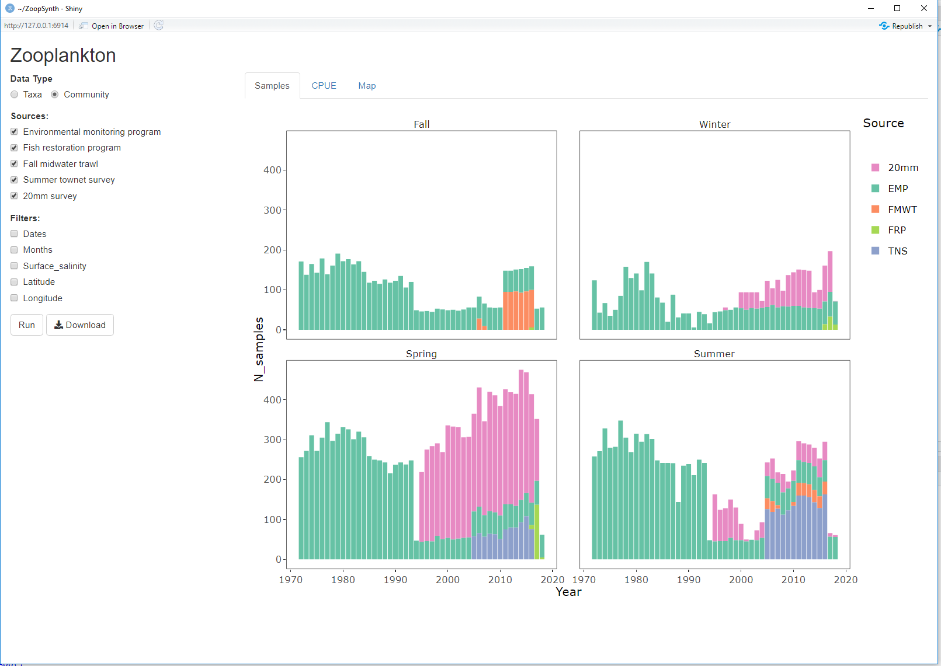

Slide 14
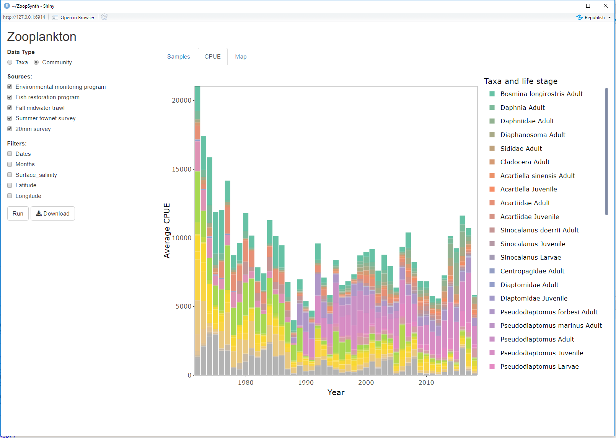

Slide 15
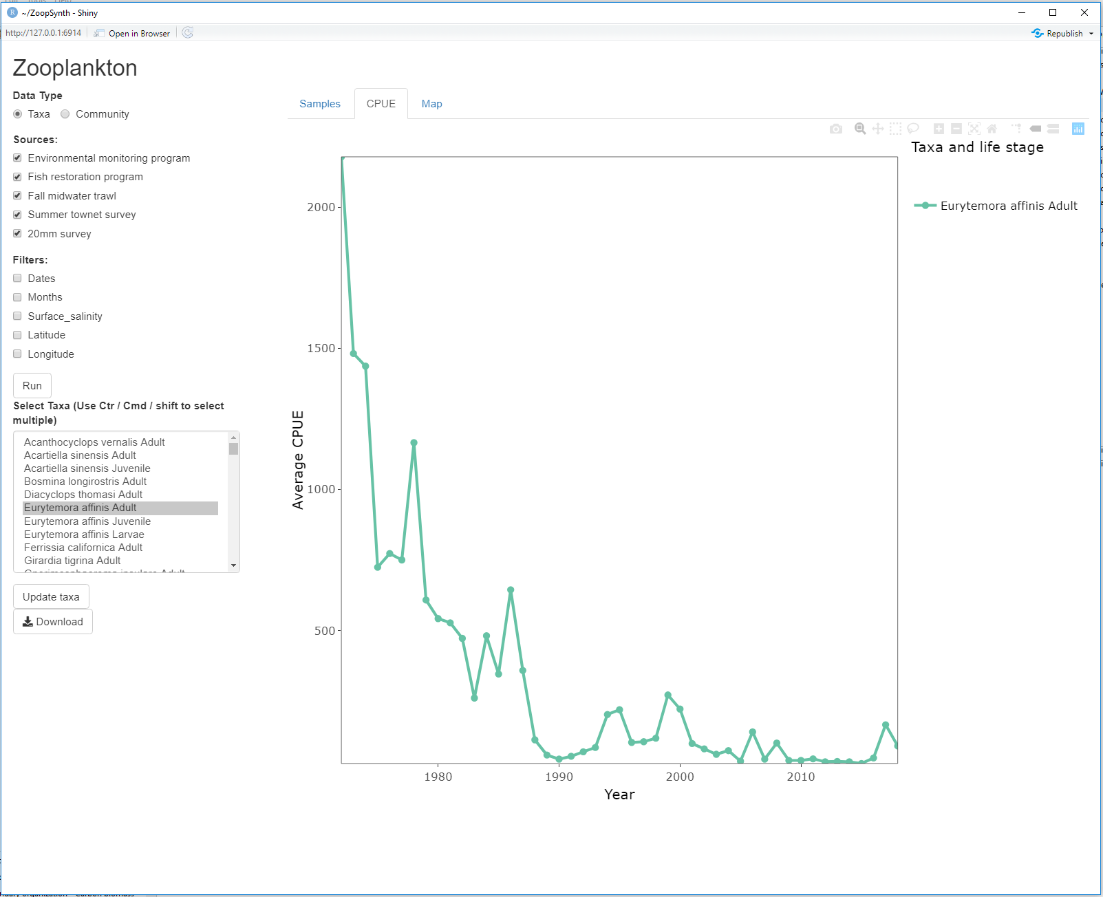

Slide 16
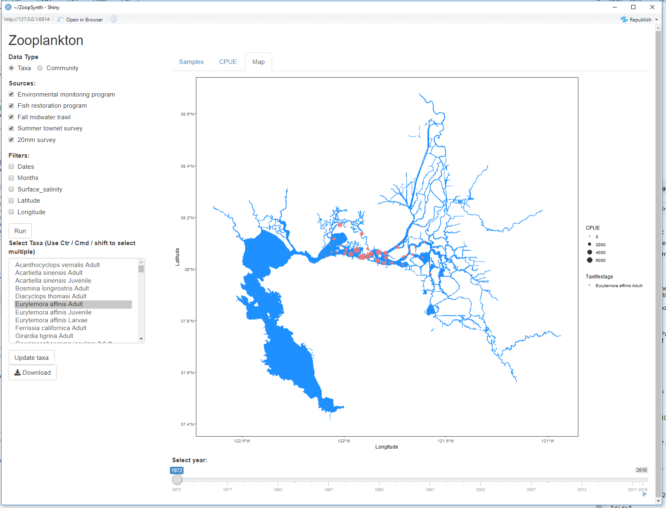

Slide 17
Solving inconsistencies in taxonomic resolution: The Taxa solution
EMP
Pseudodiaptomus forbesii
Pseudodiaptomus marinus
FMWT
Pseudodiaptomus forbesii
Pseudodiaptomus marinus
20mm
Pseudodiaptomus spp.
Pseudodiaptomus forbesii
Pseudodiaptomus marinus
Pseudodiaptomus euryhalinus
+
+
+
All Pseudodiaptomus
All Pseudodiaptomus
All Pseudodiaptomus
Combined data
EMP | FMWT | 20mm
All Pseudodiaptomus | All Pseudodiaptomus | All Pseudodiaptomus
Pseudodiaptomus forbesii | Pseudodiaptomus forbesii | Pseudodiaptomus forbesii
Pseudodiaptomus marinus | Pseudodiaptomus marinus | Pseudodiaptomus marinus
 |  | Pseudodiaptomus euryhalinus

Slide 18
Solving inconsistencies in taxonomic resolution: The Community solution
EMP
Pseudodiaptomus forbesii
Pseudodiaptomus marinus
FMWT
Pseudodiaptomus forbesii
Pseudodiaptomus marinus
20mm
Pseudodiaptomus spp.
Pseudodiaptomus forbesii
Pseudodiaptomus marinus
Pseudodiaptomus euryhalinus
+
Pseudodiaptomus spp.
Combined data
EMP | FMWT | 20mm
 |  | Pseudodiaptomus spp.
Pseudodiaptomus forbesii | Pseudodiaptomus forbesii | Pseudodiaptomus forbesii
Pseudodiaptomus marinus | Pseudodiaptomus marinus | Pseudodiaptomus marinus
 |  | Pseudodiaptomus euryhalinus

